Slide 1

Glove for deaf
Tasneem Ibraheem Sara Anis Nourhan shaaban

Slide 2
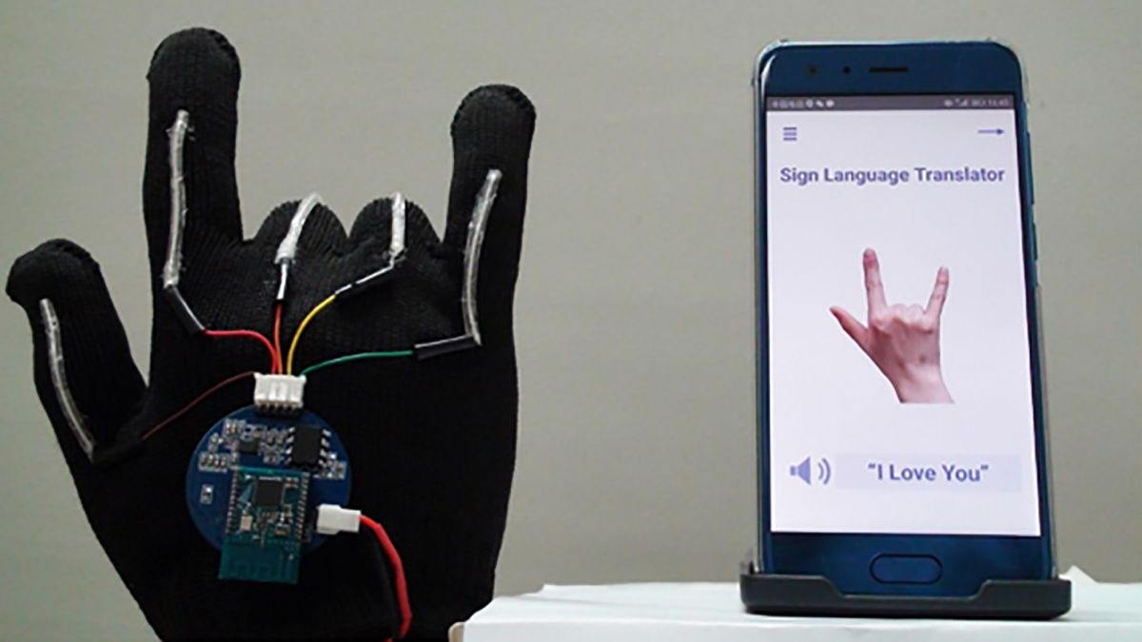
Introduction
•Deaf use the sign language to be in touch with surrounding people, unfortunately, the people must learn or know the sign language to connect with them.
•So, we will implement a device that can transcript the sign word on LCD:
Five flexible sensors must be put on all fingers respectively.
Flexible sensors fast response detect any motion of fingers.
According to the posture of fingers, the relative meaning will be printing on the LCD.

Slide 3
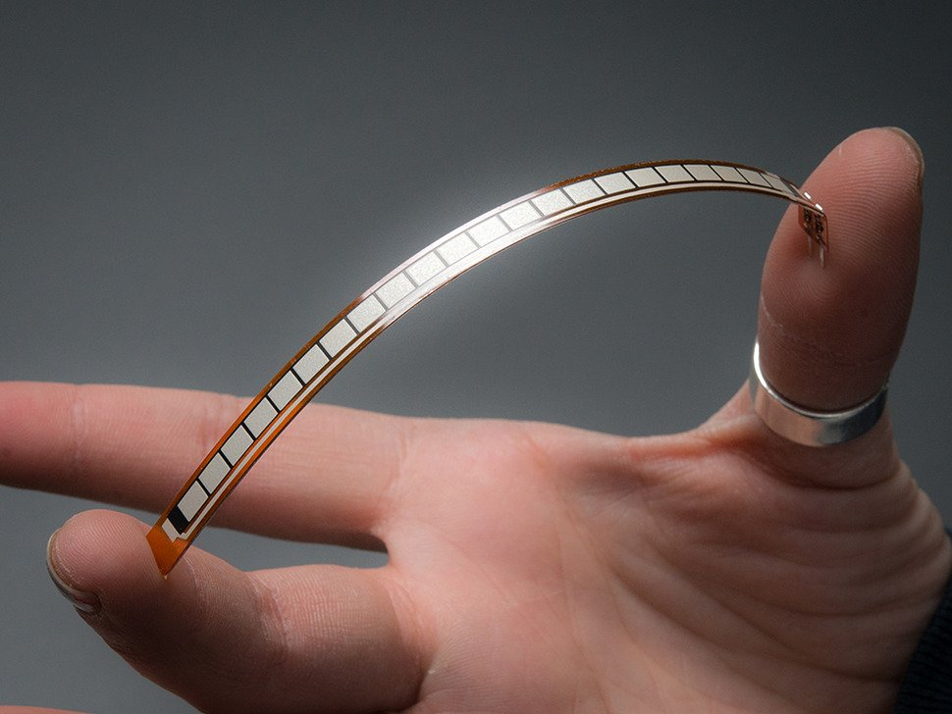
Specifications –Flexible sensors
1.They are used to detect any motion of fingers, every finger must has an individually one.
2.According to the position of pack of fingers, the relative word will be printed on LCD.

Slide 4
Features:
Flex Sensor
- Angle Displacement Measurement
- Bends and Flexes physically with motion device
- Possible Uses
- Robotics
- Gaming (Virtual Motion)
- Medical Devices
- Computer Peripherals
- Musical Instruments
- Physical Therapy
- Simple Construction
- Low Profile

Slide 5
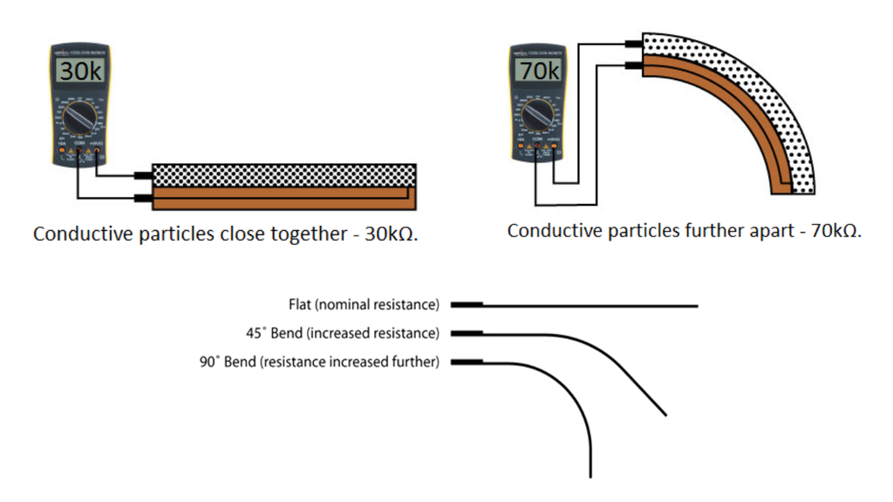
Electrical Specifications
-Flat Resistance: 10K Ohms
-Resistance Tolerance: ±30%
-Bend Resistance Range: 60K to 110K Ohms
-Power Rating : 0.50 Watts continuous. 1 Watt
Peak
Mechanical Specifications
-Life Cycle: >1 million
-Height: 0.43mm (0.017")
-Temperature Range: -35°C to +80°C

Slide 6
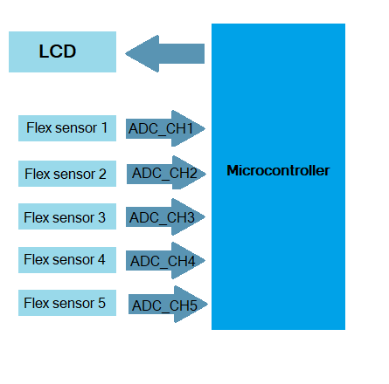
Block Diagram

Slide 7
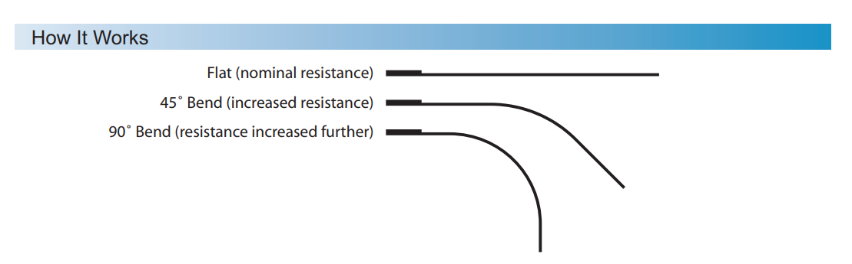
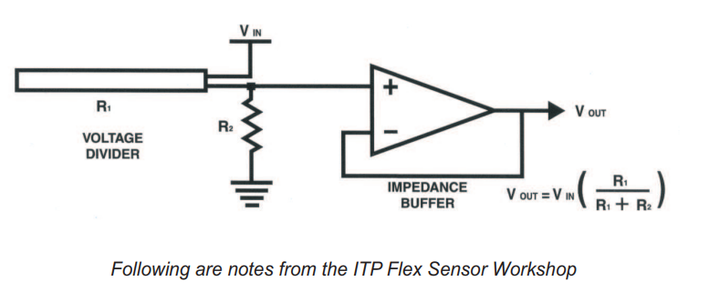
Flex sensor
How it works
Basic Flex Sensor

Slide 8
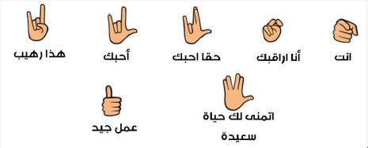
Examples

Slide 9
Summary
Expensive
Solve a problem in the community.
2 Week.

Slide 10

Thanks

